Slide 1

Know It CDAC- ACTS, Pune
A Presentation on “TravelGo”

Slide 2
1.Project Introduction:
TravelGo- Your Site for booking and Hosting Properties
Traveler-
At TravelGo, we understand that every journey is unique, and so are your accommodation preferences. Our user-friendly platform allows you to search for properties available for rent in your desired locations. From quaint countryside cottages to luxurious urban apartments, finding the ideal place to stay has never been easier. With just a few clicks, you can explore a wide range of options that suit your budget, group size, and travel style.
Host-
Have a property waiting to be discovered by travelers? Become a host on TravelGo and open your doors to a global audience. Our streamlined hosting process lets you list your property quickly and efficiently. Showcase your space with high-quality images, detailed descriptions, and availability calendars.

Slide 3
1.1 Project Background :
There is a need for a platform that allows users to easily find and book accommodations for their travel needs. With reference to Airbnb, TravelGo aims to provide a user-friendly website where travelers can search for available accommodations and property owners can list their properties for rent.

Slide 4
1.2 Goals of the project :-
The main objective of this project is to develop a website that connects travelers and property owners, allowing travelers to find suitable accommodations and property owners to monetize their properties. TravelGo aims to provide a seamless and efficient platform for booking accommodations for various travel purposes.
1.3 Customers and Stakeholders:-
Customers : -
Travelers looking for accommodations
Property owners who want to list their properties

Slide 5
Stakeholders :-
- Admin
- Local businesses in travel destinations
- Tourism industry

Slide 6
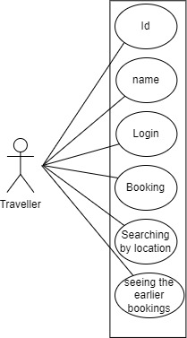
Traveller use case diagram:-

Slide 7
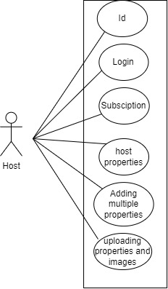
Host use case diagram:-

Slide 8
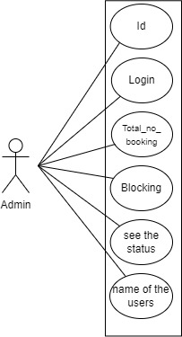
Admin use case diagram:-

Slide 9
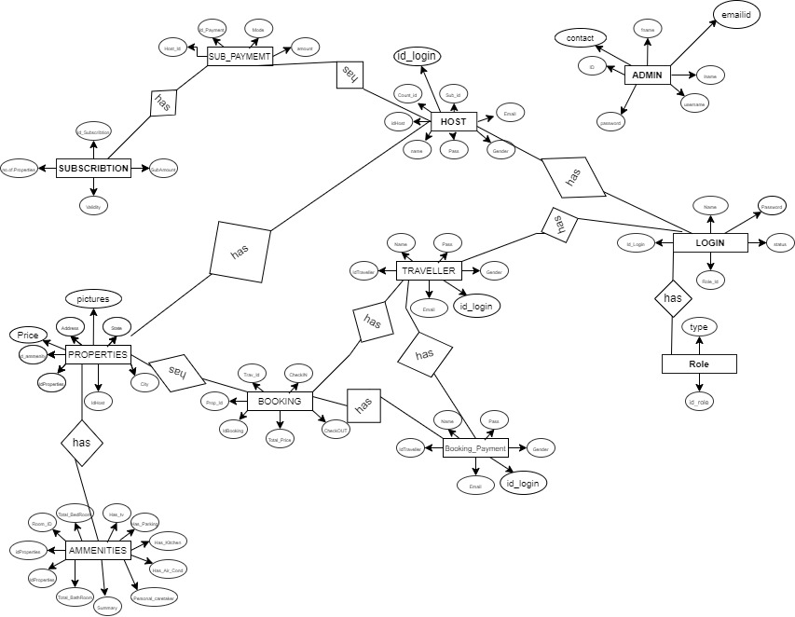
ER diagram:-

Slide 10
Project Architecture
Used For Used For
User Interfacing 1. Server Side Validation, If Needed
Basic Data Validation 2. Response Handling
3. Business Logic Used For
4. Database Operations 1. Permanent Storage
2.Database Level Validations
3. Database Access Using Stored Procedures
Technology Used
HTML, CSS
JavaScript, jQuery Technology Used
React JS 1. Spring Boot
JSON 2. Hibernate Technology Used
1. MySQL
Front End Layer
Server Layer
Database Layer

Slide 11
Technology Platform Used For Project :
Technologies used :
HTML, CSS, JavaScript, jQuery, ReactJS, JSON, Spring boot, MySQL
Reason :
Html, CSS and JavaScript are used for frontend part for static web pages.
React JS is used for rendering the dynamic web pages and to create a single page application where only particular part of web page is rendered without altering complete web page.
Spring boot is used for server side processing wherein in connection with database is established from server and required data is manipulated and sent to client side.

Slide 12
Division of work within team:
Sachin Patil : Implemented the Admin use cases and the Admin related database and the overall cycle.
Pranav Malkar: Implemented the Traveller related use cases and the overall cycle , and the part of database..
Samruddha Kumbhar : Implemented the Host related use cases and overall cycle , and the part of database. .
Prithvijeet Sonone : Implemented Login and Subscription related use cases and overall cycle ,and the part of database.
Stages at which Coordination was needed :
Most of the coordination was needed when complete UI needed to be rendered using React,
Every one worked together for designing the database.

Slide 13
Future scope:
We can add new plans where we can add package in the existing property plans.
Due to which the market value will be increase and the revenue also.
We can add review and feedback function where traveller as well as host can give feedback to each other.
Which will increase the user comfort and host comfort in the site more efficient.

Slide 14
Conclusion :
Challenges you faced :
There were many challenges that we faced like finding a write path to start with, exploring the technologies beyond the horizon of our course Etc.
Things Learnt :
We have learnt to efficiently distribute the task within the team. We have learnt to combine all the dynamic stack of technologies together to create a fully functional software.
Overall Experience :
Overall experience was very practical oriented and highly knowledgeable.
.

Slide 15

Thank You….

